Slide 1
CHAPTER 12: Networks and Data Communications
The Architecture of Computer Hardware, Systems Software & Networking: An Information Technology Approach
4th Edition, Irv Englander
John Wiley and Sons ©2010
PowerPoint slides authored by Wilson Wong, Bentley University
PowerPoint slides for the 3rd edition were co-authored with Lynne Senne, Bentley College
Note: This set of slides is well-suited for two lectures.

Slide 2
Data Communications
A simple view
data - messages to be shared between sender and receiver
communications channel that can capably and reliably transport messages
Protocols establish accurate and appropriate meaning to the messages that are understood by both senders and receivers
Physical connection that is independent of the messaging
message sharing “connection” between applications at the sender and the receiver
physical connection with signaling that represents the messages being transported
Examples
POTS - plain old telephone service
Web servers and Web browsers

Slide 3
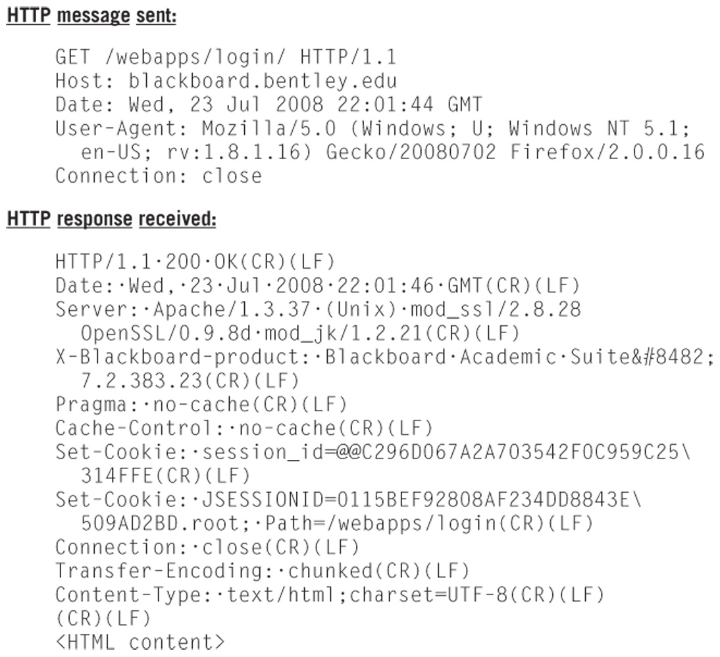
HTTP Request and Response

Slide 4
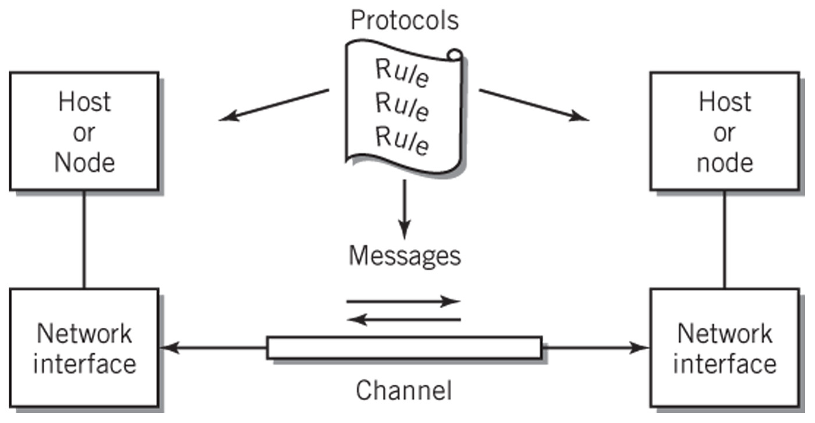
Model of a Communication Channel

Slide 5
Messages
Communication between cooperating applications at each end node
Can take many forms such as data, a program, a file, or multimedia
Represented digitally
Data is described as a byte stream because communications are predominantly serial
Limitation as a communication tool is the varying message length
Long messages could tie up a communication channel indefinitely creating problems for other messages that share that channel

Slide 6
Packets
A group of related packets make up a single message
Consist of data encapsulated by the packet header which contains information about the packet
Used to solve problems of channel availability and maximum utilization
Equivalent to an envelope that contains pages of data

Slide 7
Packet Header
Also known as the preamble
Contains
Description of the packet
Destination address of receiver
Source address of sender
Information about the data being sent

Slide 8
Advantages of Packets
Simplifies operations and increases communications efficiency
Reasonable unit for routing of data
Alternative to dedicating a channel for the entire length of the message
Packets from several sources can share a single channel
Each sender/receiver pair appears to have a channel to itself
Receiving computer can process an entire block of data instead of a character or byte at a time
Simplifies synchronization of the sending and receiving systems by providing clear start and stop points

Slide 9
Channel Characteristics (1)
Communication channel
The path for the message between two communicating nodes
May include intermediate nodes that forward packets to the next node
Interfaces at each end of the connection may be different
Links
A segment of a communication channel
Bandwidth
Bit rate of overall channel
Medium
Guided – communications limited to a specific path
Unguided – communications not limited to a specific path

Slide 10
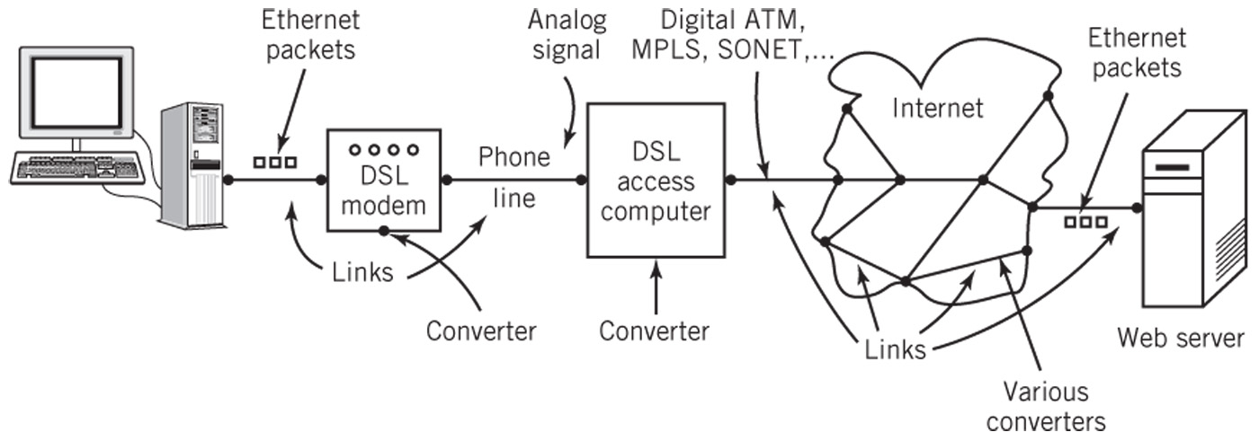
A Multi-Link Channel

Slide 11
Channel Characteristics (2)
Data transmission directionality
Simplex – messages are carried only in one direction
Half-duplex – messages are carried in both directions but only one direction at a time
Full duplex – messages are simultaneously carried in both directions
Number of connections
Point-to-point
Multipoint
Digital vs. Analog
End node interfaces
Wired or wireless Ethernet
Bluetooth, WiMax, DSL or cable link, modem, etc.

Slide 12
Packet Routing
Circuit switching
Dedicated channel between source and destination for duration of connection
Virtual circuit
A channel path that is used to send packets between two end nodes
Intermediate nodes may be shared with other channel paths
Packet switching (datagram switching)
Each packet is routed from node to node independently based on various criteria

Slide 13
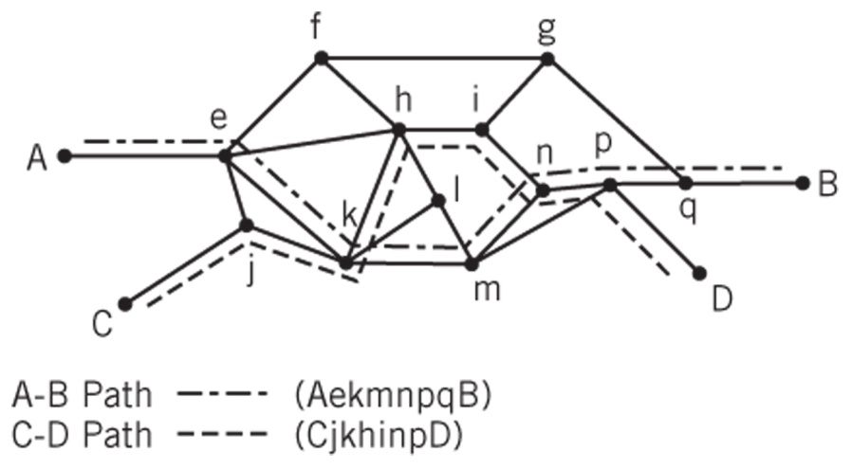
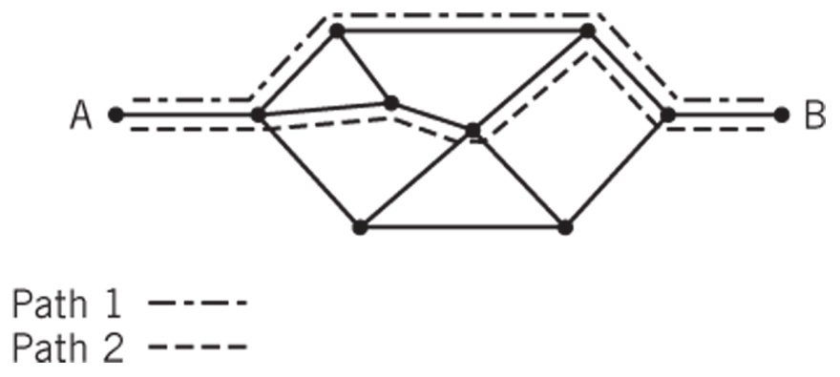
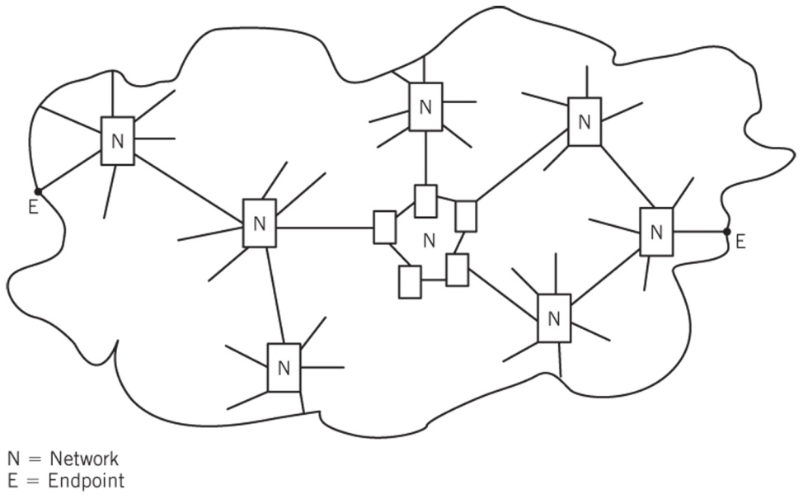
Packet Routing
End-to-end channel with many possible paths through intermediate nodes
Virtual Circuits in a Network
Connecting End Points through Links and Networks

Slide 14
Packet Routing
Routers
Specialized devices used to interconnect network and pass packets from one network to another
Operation (see following slide)
When packet arrives at input port
Processor decides where packet is to be directed
A switch is set to direct the packet to the correct output port
Gateways
Same as routers but connect dissimilar networks together
Convert packet headers for the dissimilar networks

Slide 15
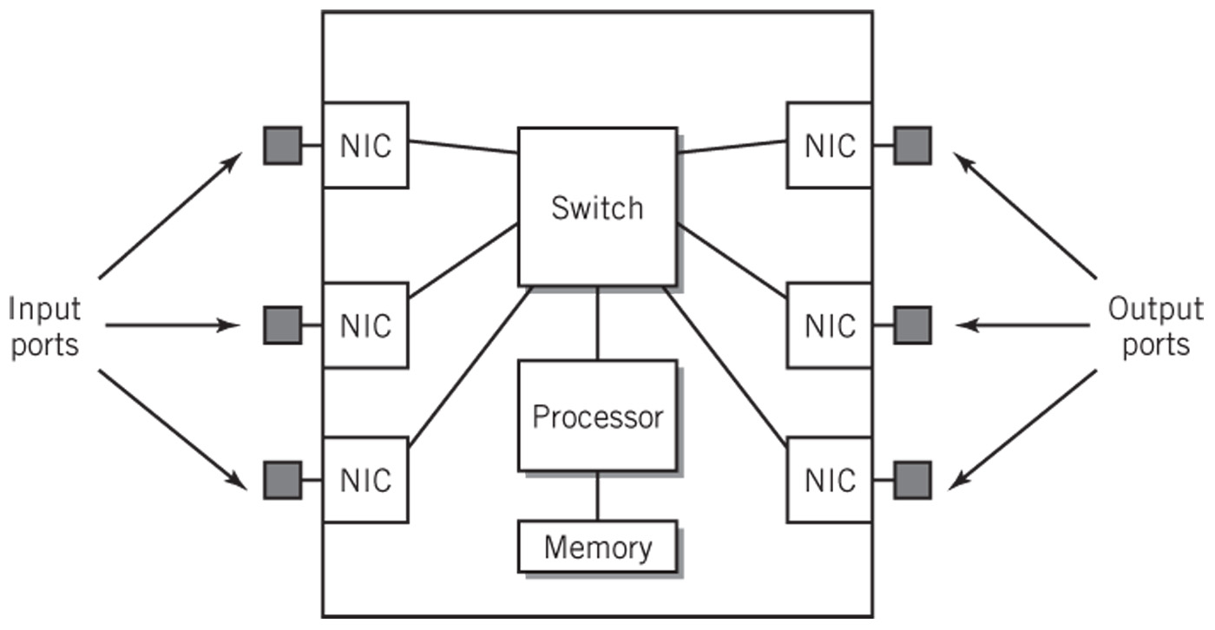
Router Block Diagram

Slide 16
Network Overview
Communication Models
TCP/IP
OSI
Addressing
Network Topology
Types of Networks
Local Area Networks
Backbone Networks
Metropolitan Area Networks
Wide Area Networks
Internet Backbones and the Internet
Piconets
Standards

Slide 17
Communication Model
Implemented as a hierarchical protocol stack
Each layer of the stack at the sender node contributes information that is used by the corresponding peer layer at the receiver node
Different protocols for the different aspects of communication
Separating tasks and including well defined interfaces between the tasks
Adds flexibility
Simplifies design of protocols
Permits modification or substitution of protocols without affecting unrelated tasks
Permits a system to select only the protocols needed for a particular application

Slide 18
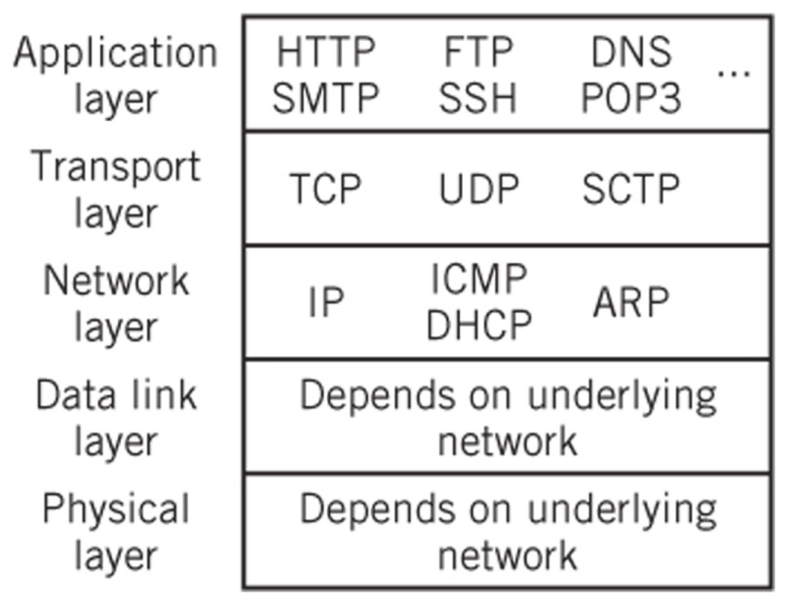
TCP/IP
Transmission Control Protocol/Internet Protocol
Based on five protocol layers, although layers 1 and 2 are not actually specified in the standard. However, the TCP/IP model recognizes the existence of these layers as a necessity.
The TCP/IP protocol suite encompasses an integrated suite of numerous protocols that work together and guide all aspects of communication.
Layer 5
Layer 4
Layer 3
Layer 2
Layer 1

Slide 19
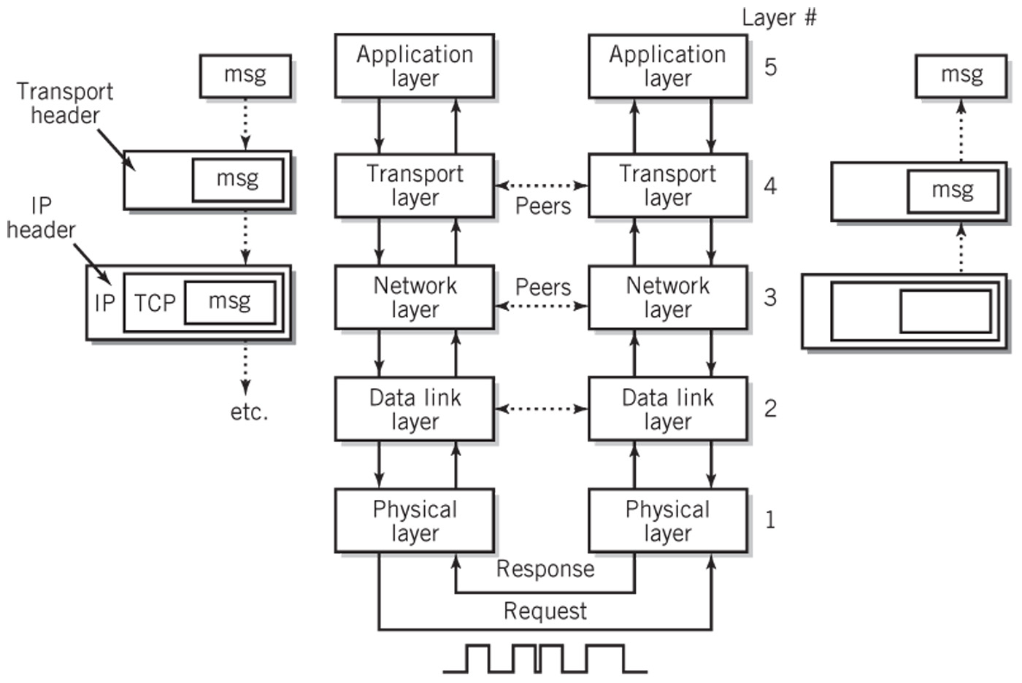
Operation of TCP/IP Model

Slide 20
Application Layer (Layer 5)
Layer where message is created
Includes any application that provides software that can communicate with the network layer
Sockets
Originated with BSD UNIX
Provide the interface between the application layer and transport layer
Used by applications to initiate connections and to send messages through the network
A means for adding new protocols and keeping the network facilities current in their offerings
Example: SCSI over IP

Slide 21
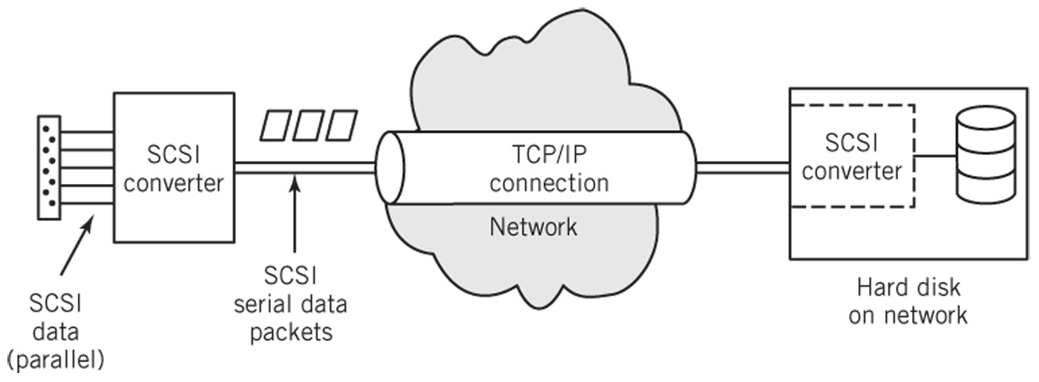
SCSI over IP

Slide 22
Transport Layer (Layer 4)
Provides services that support reliable end-to-end communications
Generates the final address of the destination
Responsible for all end-to-end communication facilities
Packetization of the message, breaking up of the message into packets of reasonable size takes place at this level
Three different protocols
TCP
UDP
SCTP

Slide 23
Transport Layer Protocols
TCP (Transmission Control Protocol)
Reliable delivery service
Sending and receiving TCP each create a socket
Control packets are used to create a full duplex connection between the sockets
A single TCP service can create multiple connections that operate simultaneously by creating additional sockets as needed
Routing is the responsibility of the network layer (layer 3)
UDP (User Datagram Protocol)
Unreliable, connectionless service
No acknowledgment of receipt by receiving node
Example: streaming video
SCTP (Stream Control Transmission Protocol)
Similar to TCP but with improved fault tolerance and ability to transport multiple messages through the same connection

Slide 24
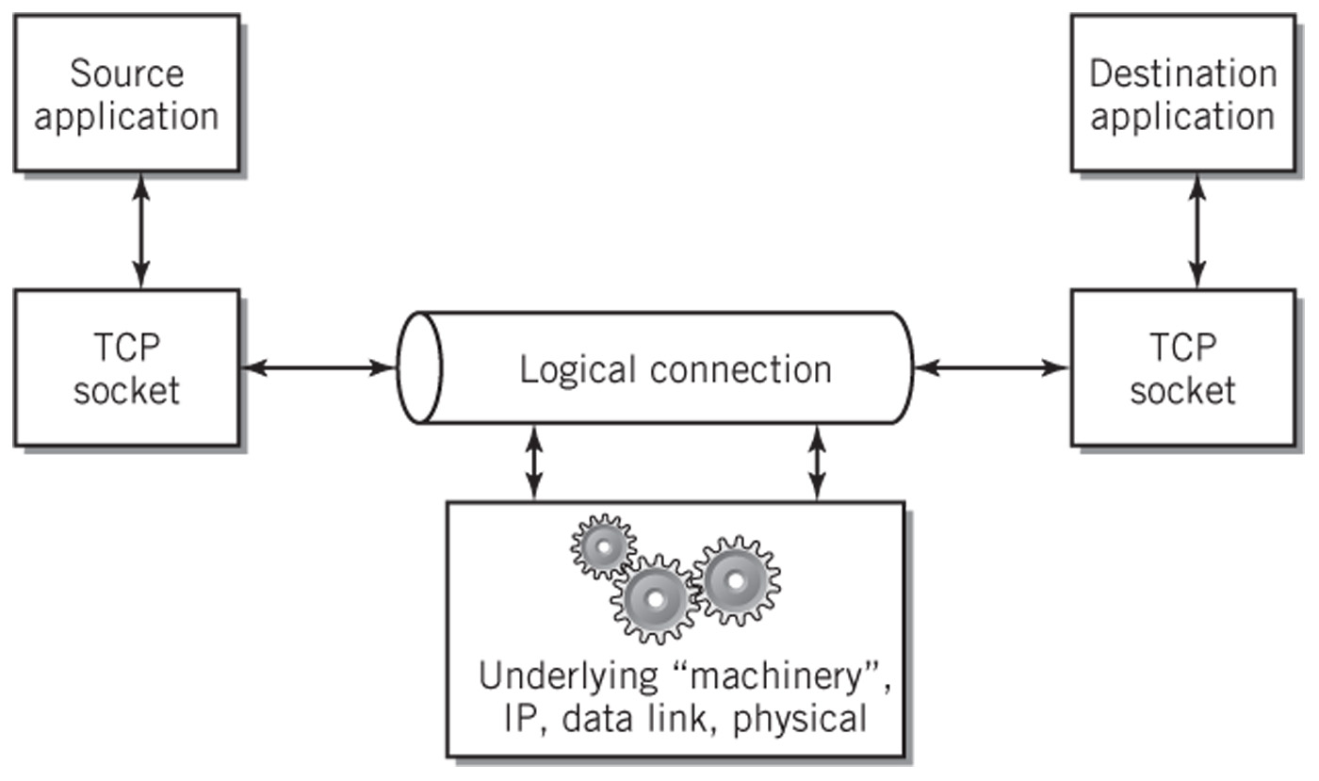
Logical Connection View of TCP

Slide 25
Network Layer (Layer 3)
The TCP/IP network layer is also called the internetworking layer or the IP layer
Responsible for the addressing and routing of packets to their proper and final destination
Unreliable, connectionless, packet switching service
Does not guarantee delivery nor check for errors
Routers and gateways are sometimes referred to as level 3 switches to indicate the level at which routing takes place

Slide 26
Network Layer (cont.)
Communications within a local network:
No routing is required because nodes are directly addressable
Physical addresses for corresponding IP addresses are looked up in a table
IP appends a header with the physical address and passes the datagram to the data link layer (layer 2)
Communications sent outside of the local network
At each intermediate node, the network layer removes the current node address and determines the next node address
The new address is added to the packet and passed to the data link layer (layer 2)

Slide 27
Data Link Layer (Layer 2)
Responsible for the reliable transmission and delivery of packets between two adjacent nodes
Packets at this layer are called frames
Often divided into the following two sublayers:
Software logical link control sublayer
Error correction, flow control, retransmission, packet reconstruction and IP datagram/frame conversions
Numbers frames and reorders received frames to recreate the original message
Rarely used
Hardware medium-access control sublayer
Defines procedures for access the channel and detecting errors
Responsible for services such as data encoding, collision handling, synchronization, and multiplexing

Slide 28
Physical Layer (Layer 1)
Layer at which communication actually takes place consisting of a bare stream of bits
Primarily implemented in hardware by a network interface controller (NIC)
Physical access protocol includes
Definition of the medium
Signaling method, signal parameters, carrier frequencies, lengths of pulses, synchronization and timing issues
Method used to physically connect the computer to the medium

Slide 29
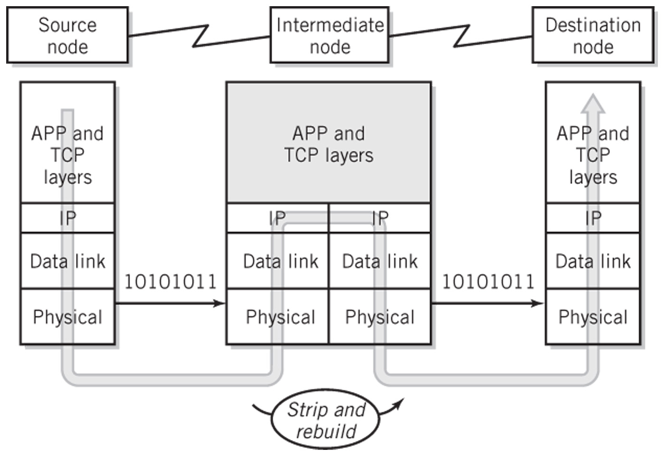
Passing a Message Through an Intermediate Node

Slide 30
OSI Model
Open Systems Interconnection Reference Model was created by the International Standards Organization (ISO)
Although a conceptually important model, OSI is not widely accepted or used for actual communication
Contains seven layers instead of five
The application layer in the TCP/IP model is essentially represented by three layers in the OSI model
Application layer
Presentation layer
Session layer

Slide 31
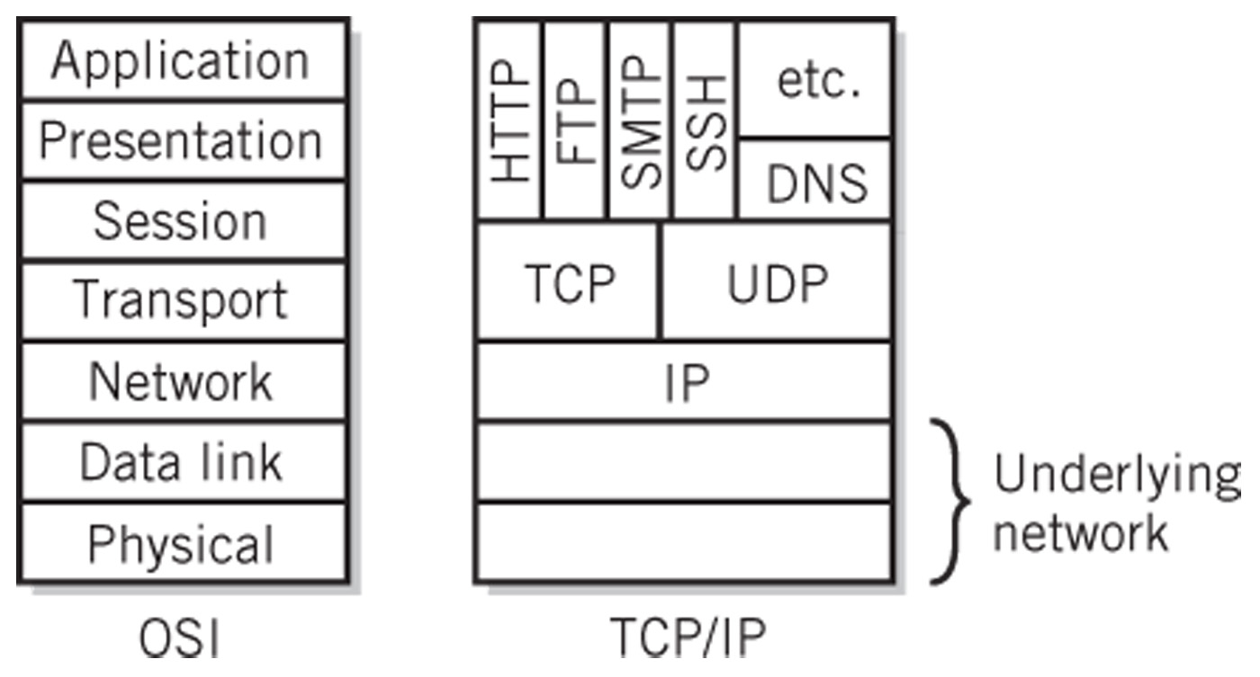
Comparison of OSI and TCP/IP

Slide 32
OSI Presentation Layer
Responsible for presenting data at the destination with the same meaning and appearance as it would have at the source
Provides common data conversions and transformations that allow systems with different standards to communicate
Includes services such as data compression and restoration, encryption and decryption, data reformatting, ASCII-Unicode conversion, etc.

Slide 33
OSI Session Layer
Establishes a dialogue between two cooperating applications or processes at the ends of the communication link
Responsible for
Establishing the session between the applications
Controlling the dialogue
Terminating the session
Examples
Remote login
Print spooling to remote printer

Slide 34
TCP/IP Addressing (1)
User friendly addresses
URL – www.youtube.com
Email – somebody@yahoo.com
Printer name on the network
Domain name
Standard global domain name system provides global scope for user friendly addresses
Hierarchical system for name creation and registration
Tools for locating and identifying specific names

Slide 35
TCP/IP Addressing (2)
Port Addresses (port numbers)
Transport layer uses to identify the application that is to receive the message
16 bits in length
Example: port 80 is commonly used for Web services
First 1024 numbers are called well-known ports because they are standard addresses specified for most common applications
User defined port numbers are also available to applications
For example, the following Web service uses the user-defined port of 8080 http://www.somewhere.org:8080/hiddenServer/index.html

Slide 36
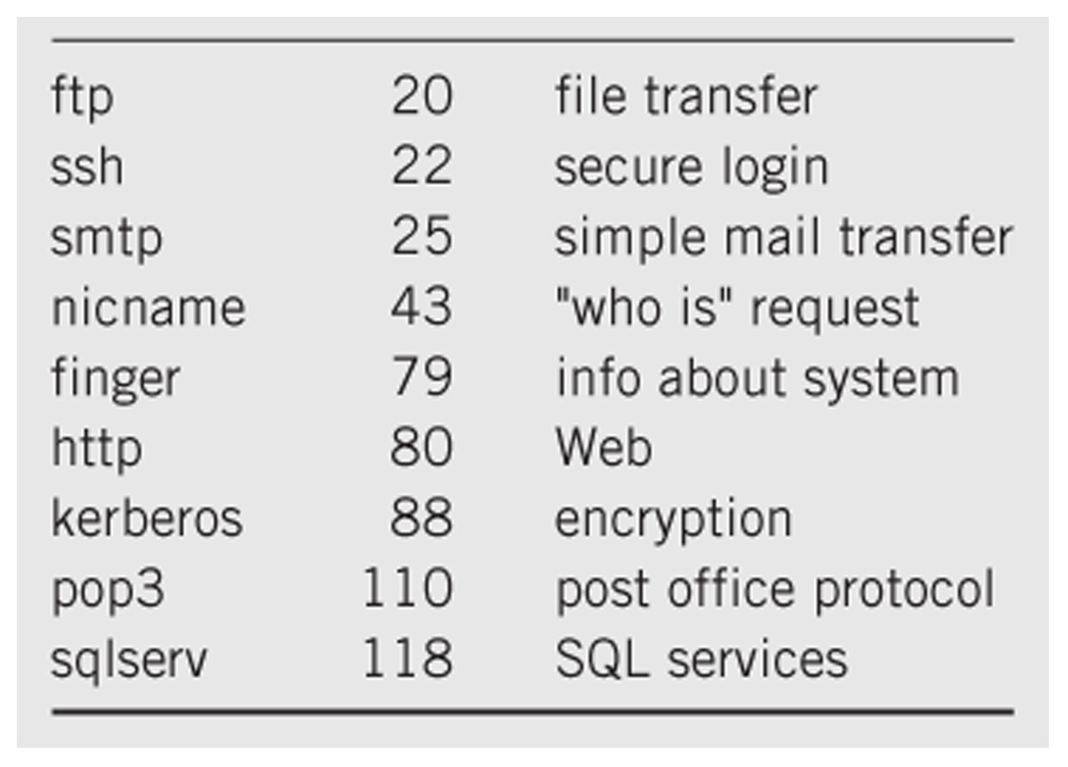
Well-Known Port Addresses

Slide 37
TCP/IP Addressing (3)
IP addresses
Logical addresses
IPv4
32-bit addresses arranged as 4 octets, delimited by dots
Each octet is written as a decimal number between 0 and 255
Example: 208.80.152.2 (Wikipedia’s IP address)
IPv6
Intended to eventually supplant IPv4 to provide additional IP addresses
128-bit addresses arranged as 8 groups of four-digit hexadecimal numbers separated by colons
Leading zeros and zero values in one or more consecutive groups may be eliminated
Example: 6E:2A20::35C:66C0:0:5500 is the same as 006E:2A20:0000:0000:035C:66C0:0000:550

Slide 38
TCP/IP Addressing (4)
Domain name translation
Translate a user friendly address into an IP address and port address for the transport layer
Utilizes a global domain name directory service
Address resolution protocol (network layer)
Translates IP addresses into physical addresses
MAC (medium-access control) address
Most common type of physical address
Every manufactured device that may connect to a network anywhere in the world is supplied with a permanent, unique MAC address
Format consists of 48 bits arranged as 6 two-digit hexadecimal numbers separated by colons
Example: 00:C0:9F:6C:F9:D0

Slide 39
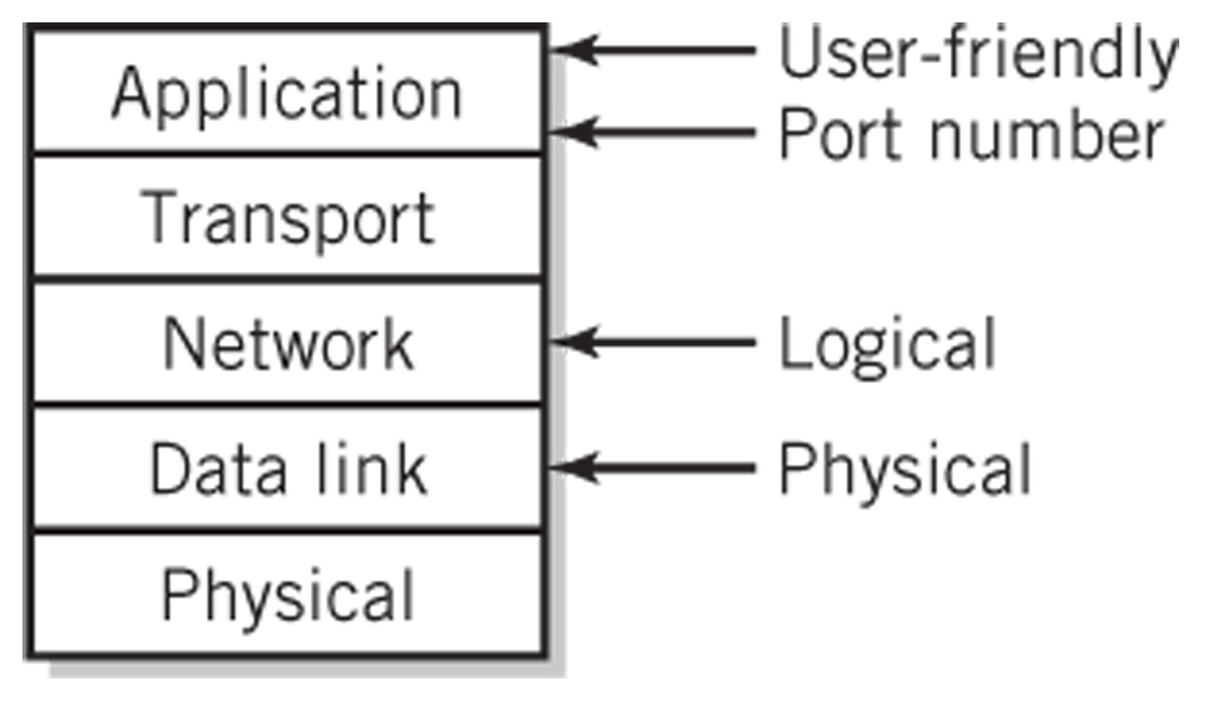
Different Addresses Used in a Network

Slide 40
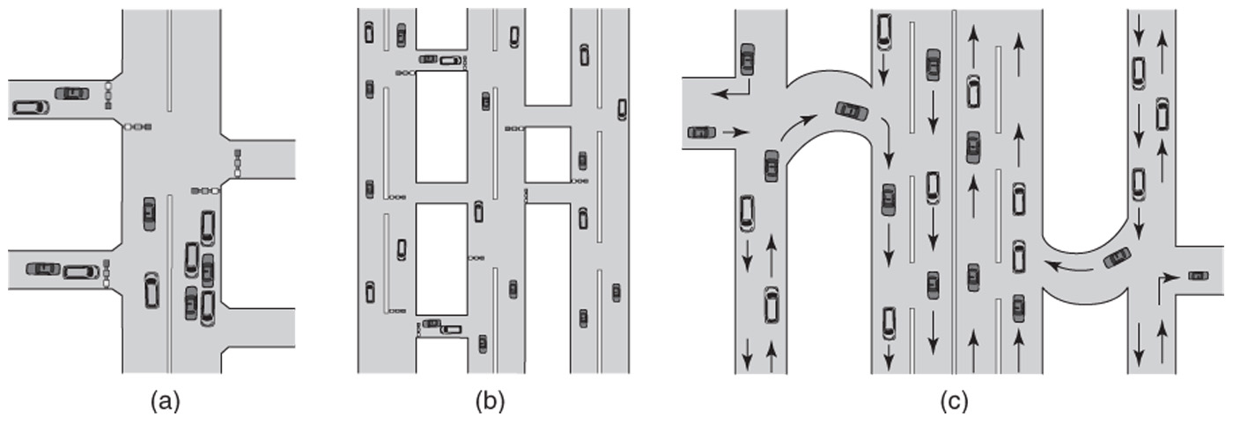
Network Topology
Fundamental layout of a network
Describes the path or paths between any two points in the network
Affects availability, speed and traffic congestion of the network
Logical topology – operational relationship between the various network components
Physical topology – actual layout of the network wiring
Automobile Traffic Scenarios

Slide 41
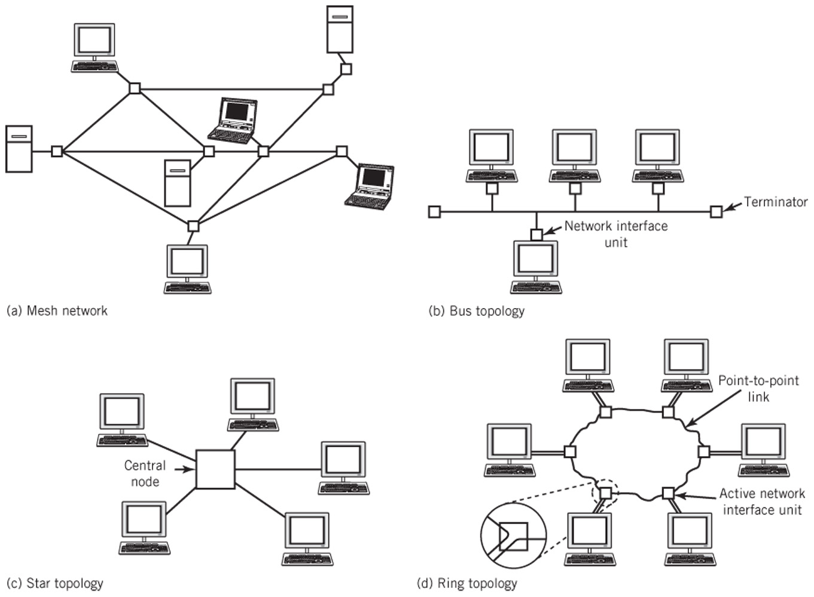
Four Network Topologies

Slide 42
Mesh Topology
Multiple paths between end nodes
Failure of an individual intermediate node will slow but not stop the network as long as an alternative path is available
Large networks that use switches and routers are typically partial mesh networks
Full mesh network
Direct point-to-point channel connecting every pair of nodes
Impractical due to the large number of connections needed
Number of connections = nodes x (nodes – 1) / 2
500 computer nodes would require 125,000 interconnecting cables!

Slide 43
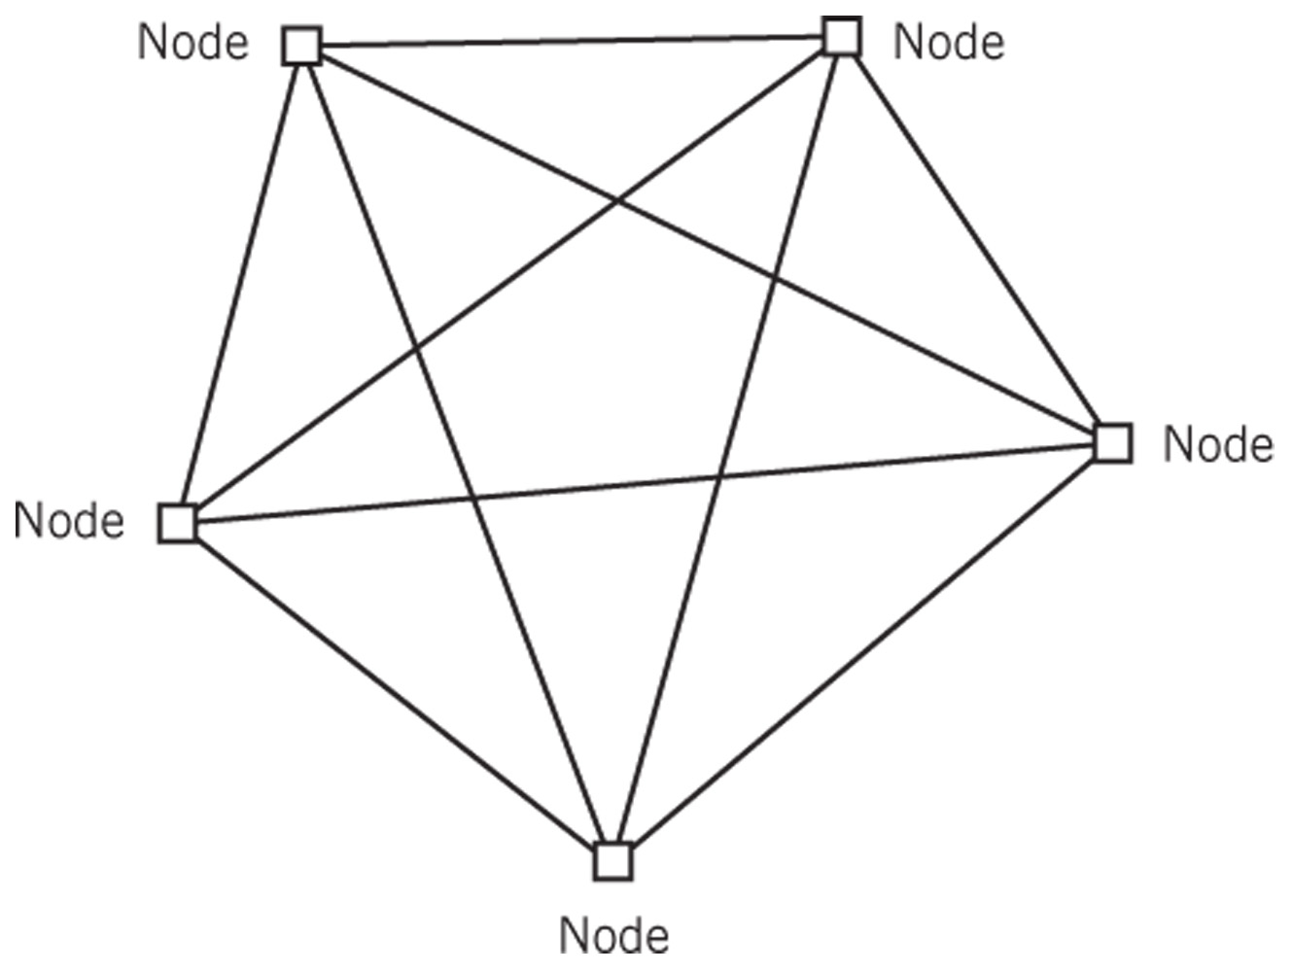
Five-Node Full Mesh Network

Slide 44
Bus Topology
Similar to multipoint buses in chapter 7
Each node is tapped into the bus along the bus
To communicate, each node “broadcasts” a message that travels along the bus
Every node on the bus receives the message but it is ignored by all nodes except the one whose node matches the delivery address in the message
Transmission from any stations travels entire medium (both directions)
Termination required at ends of bus to prevent the signal from echoing
Branches can be added to a bus, expanding it into a tree but messages are still broadcast throughout the entire tree

Slide 45
Bus Network Implementation
Only requires a single pair of wires from one end of the network space to the other
Easiest to wire of the network topologies
Low cost
Traffic congestion is a major issue
Rarely used in designs of new networks except for wireless networks
Because of the unguided nature of radio waves, wireless networks require some form of bus topology

Slide 46
Star Topology
Primarily used for local area networks and sometimes used to connect satellite offices to a central office
All nodes are connected point-to-point to a central device
Nodes communicate through the central device
Switching in the central device connects pairs of nodes together to allow them to communicate directly
Central device can steer data from one node to another as required
Most modern switches allow multiple pairs to communicate simultaneously
Failure of central device causes entire network to go down

Slide 47
Ring Topology
Point-to-point connection from each node to the next
Last node is connected back to the first to form a closed ring
Each node retransmits the signal that it receives from the previous node in the ring
Packets are placed on the loop at a node, and travel from node to node until the desired node is reached
Although the ring is inherently unidirectional, it is possible to build a bidirectional ring network
Popular in the past because they provided a controlled way in which to guarantee network performance
Legacy token-ring local area networks
Used in some FDDI fiber optic backbone and metropolitan area networks

Slide 48
Local Area Networks (LAN)
A network that connections computers and other supporting devices over a relatively small localized area
Typically ranging in size from a single room to multiple buildings in close range of each other
Most of the computers are personal computers or workstations
Routers and perhaps gateways are used to connect the LAN to other networks
Creating separate LANs for different departments or for different business functions is done to minimize extraneous traffic on the network
Most modern LANs are based on one of the Ethernet protocol standards

Slide 49
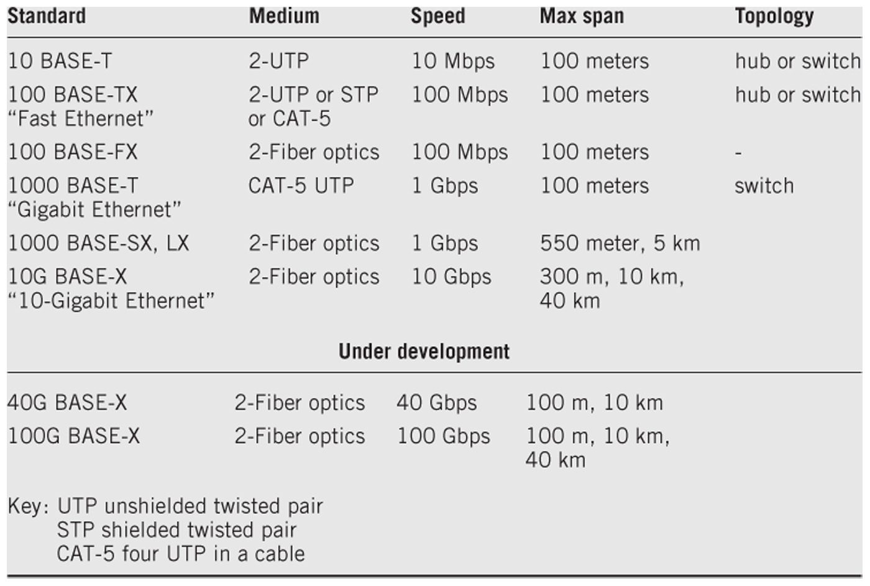
Common Ethernet Standards

Slide 50
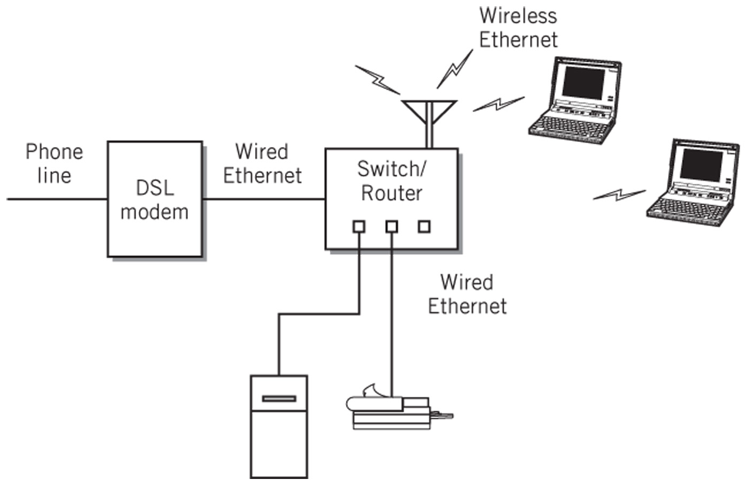
Typical Home Network

Slide 51
Ethernet Hubs
Based on bus topology
A passive central connection device used to simplify wiring and maintenance
Physical layer device where all of the connections are tied together inside the hub
Signals are broadcast to every device connected to the hub
Uses the CSMA/CD medium access control protocol
Use of hubs is declining because switches often provide better performance

Slide 52
Ethernet Switches
Logically a star topology, not a bus topology
Able to set up a direction connection between any two nodes
Multiple pairs of nodes can communicate at the full bandwidth
Prevalent method for wired local area networks

Slide 53
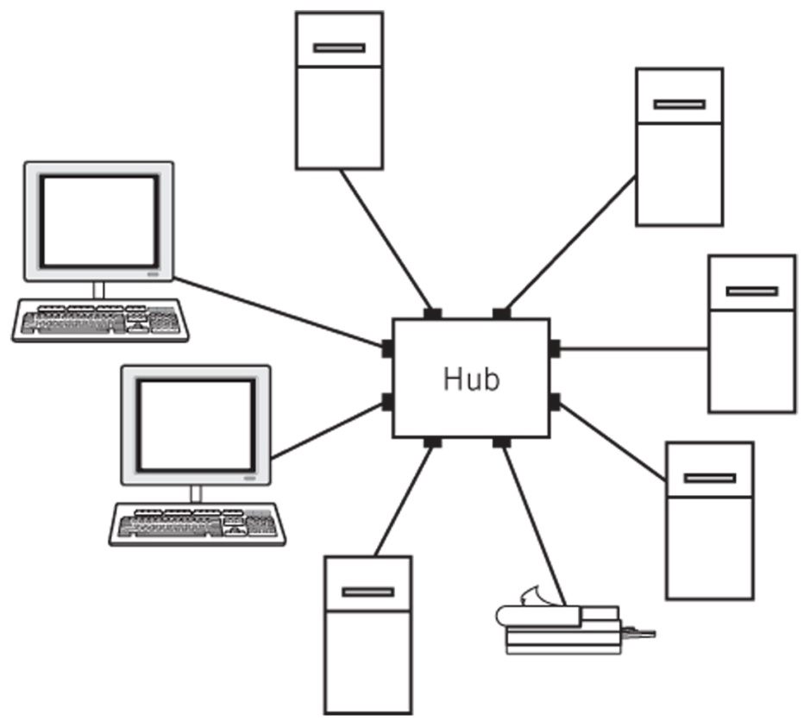
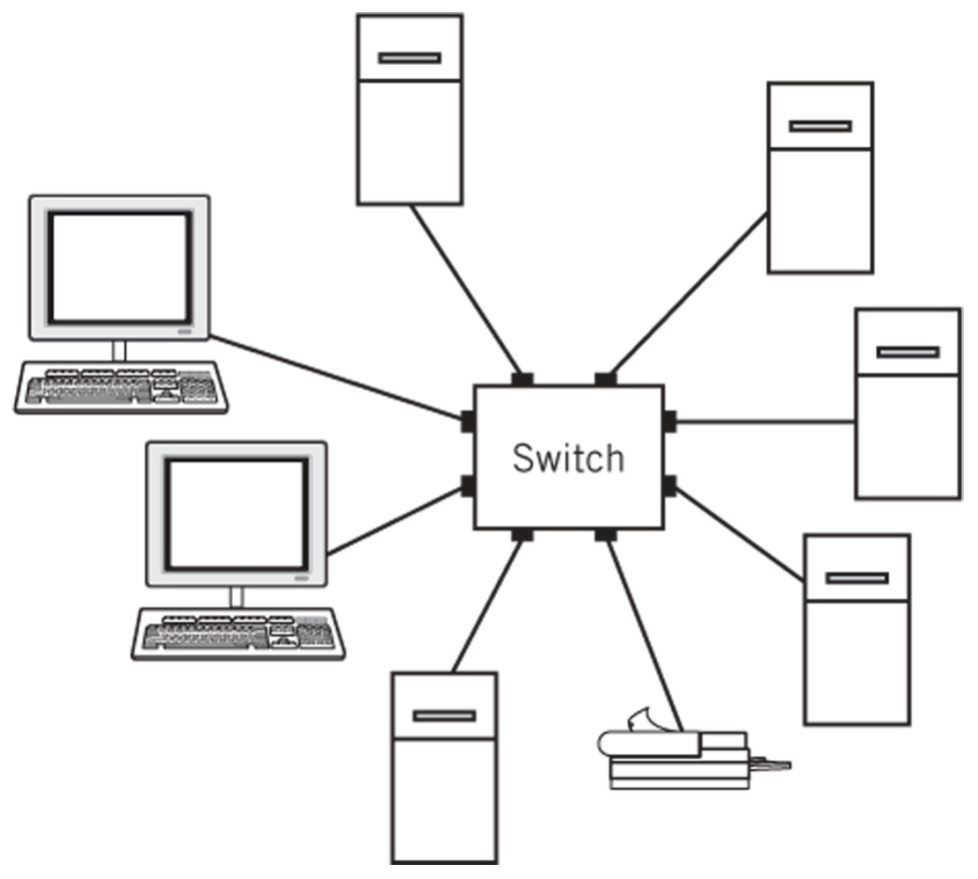
Hub vs. Switch Based Ethernet
Logically a bus and can be viewed as a zero-length bus
Logically and physically a star topology

Slide 54
Wireless Ethernet (WiFi)
Radio-based compatible extension to the Ethernet standard
Central access point is similar to a hub but is an active node
Central access point transmits and receives radio waves to communicate with the nodes
Radio space must be shared between the nodes
Does not use the CSMA-CD protocol because it is possible for units to be far away that although they can communicate with the access point, they cannot detect one another

Slide 55
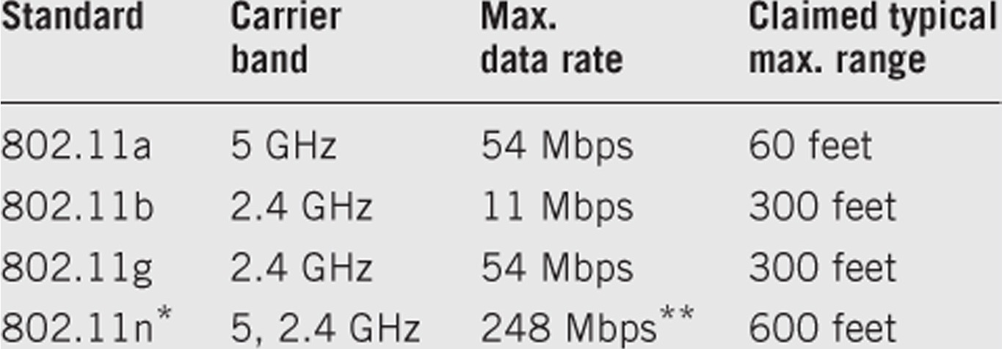
Wireless Ethernet Characteristics
* Unofficial as of June 2008
** Possible future theoretical maximum data rate of 600 Mbps

Slide 56
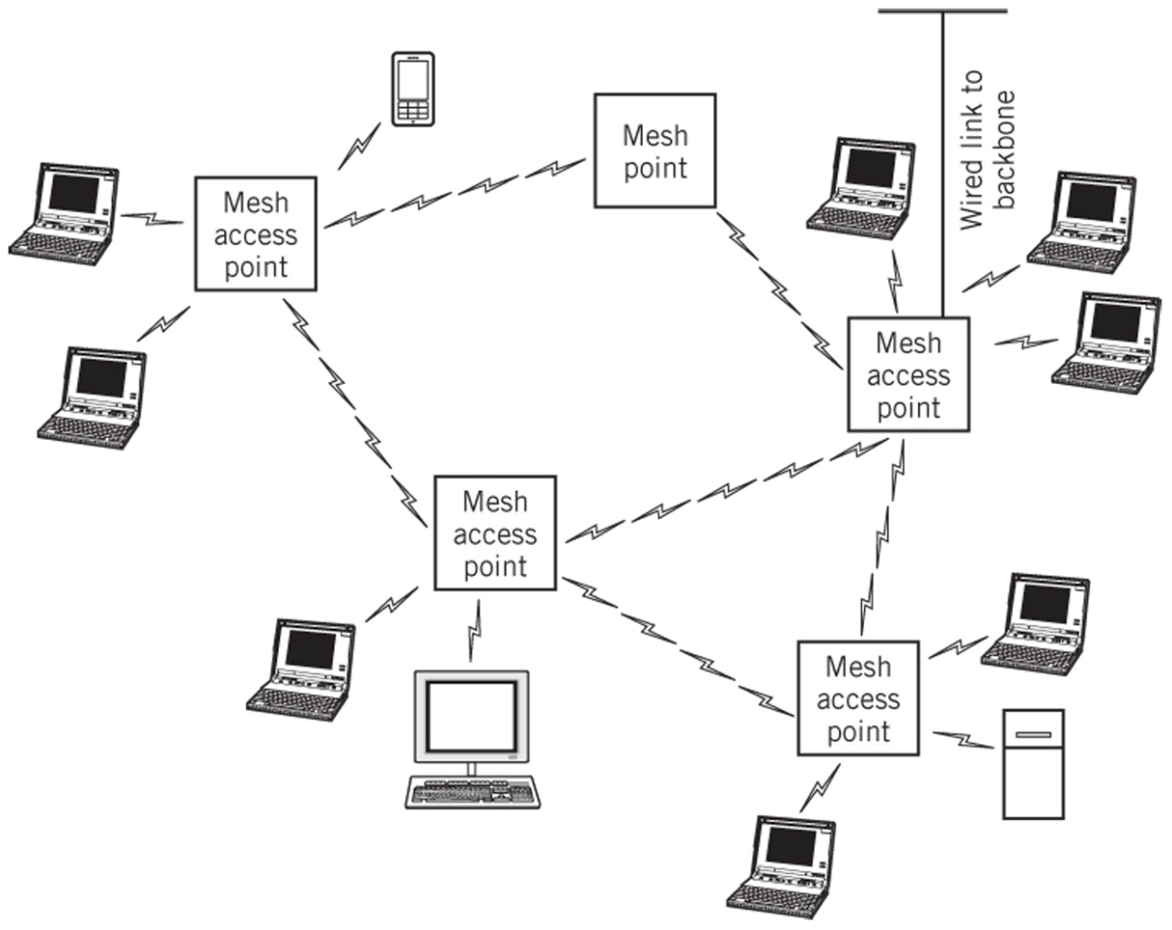
Wireless Mesh Network
Mesh points operate at the medium-access control layer and do not require wiring

Slide 57
Backbone Networks
Also called tiered Ethernet
Ties together LANs and provides access to external networks like the Internet
Chief motivation is to improve overall performance of a larger network by creating separate networks for groups of users who primarily communicate with one another
Communicate between the LANs is enabled only when necessary
Overall range of the network can be extended beyond the limits of a single LAN
Can be viewed as a large LAN where each node is itself a LAN
Intranets – an organizational network where user interfaces and applications are primarily based on Web services

Slide 58
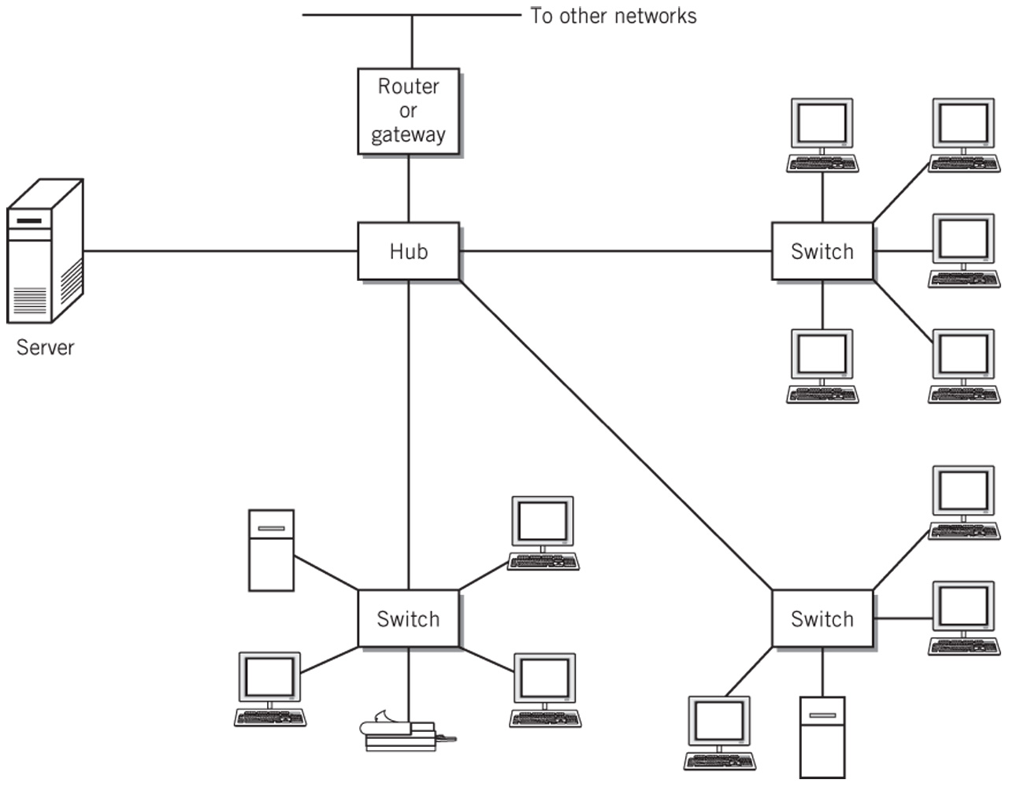
Backbone Network

Slide 59
Metropolitan Area Networks
A network larger in geographical scope than a LAN but within a range of less than 30 miles or 50 km
Often there is a desire to create network links to link locations that would require running wires through someone else’s property.
Requires services from a service provider or public carrier
Begins to resemble a WAN
Edge connection – a connection at an access point on the customer’s premises that connects to a provider
Campus area network (CAN)
Network type between a LAN and a MAN
Number of interconnected buildings clustered together

Slide 60
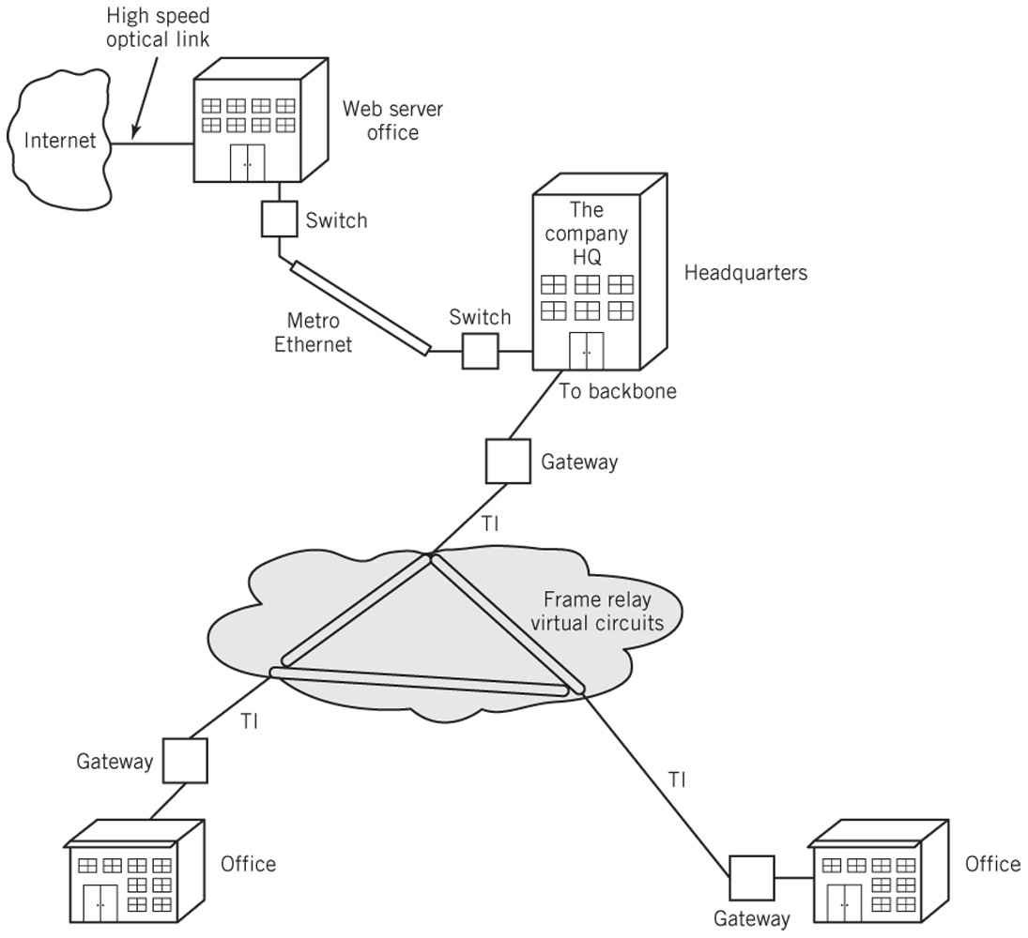
Metropolitan Area Network

Slide 61
Wide Area Networks (WAN)
Facilitate communications between users and applications over large geographical distances
Distinguishing feature is the extensive reliance on service providers to provide the required connectivity between nodes
The carrier network is sometimes represented as a collection of private virtual networks
Primary reasons for WANs
Organization requires data communication links between widely spread facilities and between an organization and its external contacts
Organization requires fast access to the Internet, either as a consumer or as a provider of Internet services, or both
Extranet
A connection between a business and its business partners that usually uses the Internet as a medium for its activities

Slide 62
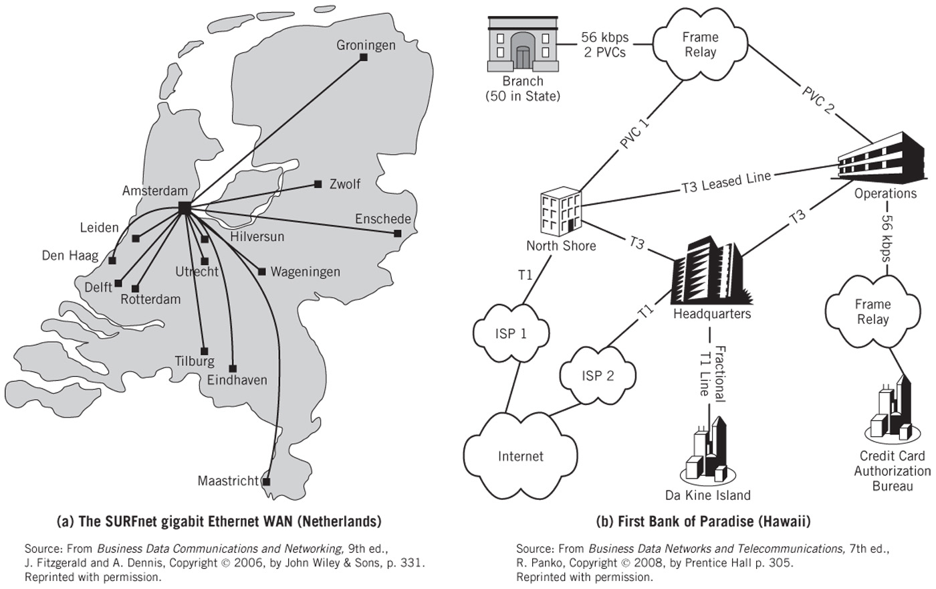
Two Real-World WANs

Slide 63
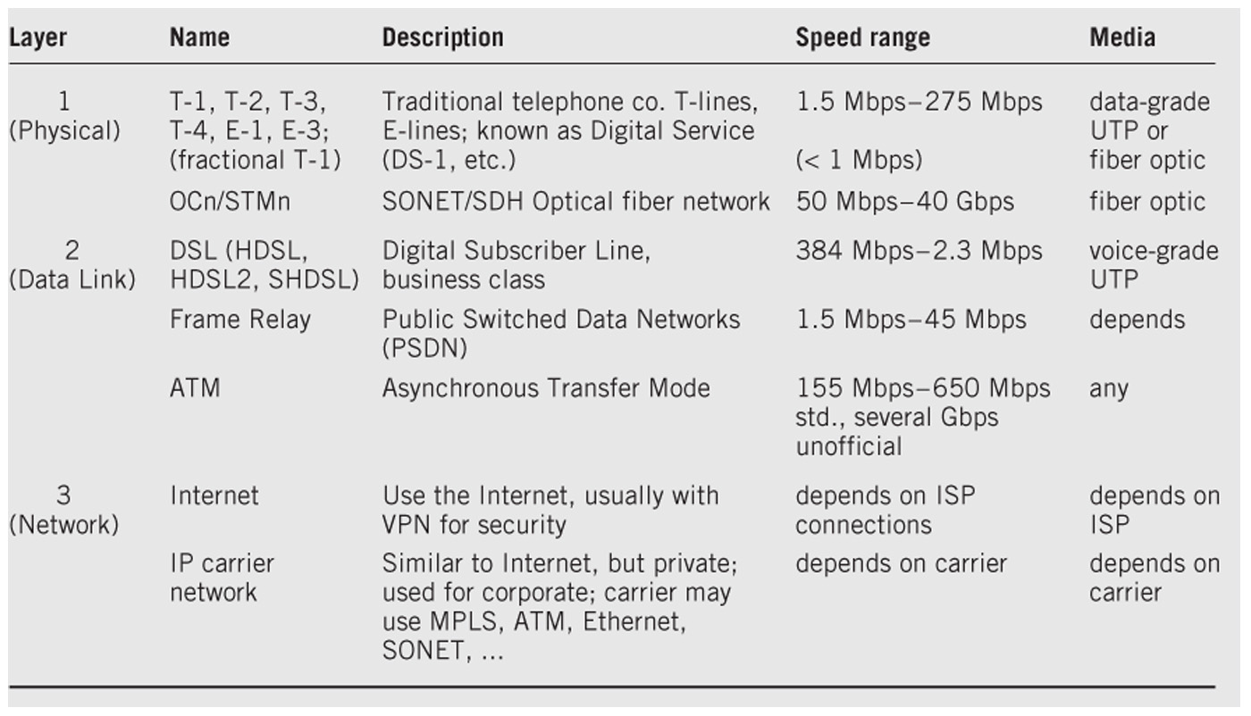
Wide Area Network Carrier Options

Slide 64
Internet Backbones and the Internet
Internet Service Providers (ISPs)
Internet backbone
High speed fiber optic networks that carry traffic between major cities throughout the world
Speed ranges from 45 to 625 Gbps with faster backbones in the future
Created to speed network traffic that would otherwise require many slow hops to the final destination
No official central backbone and no official guidance for its development
Network access points
Interchanges between the backbones
Local ISPs receive their service from regional ISPs who, in turn, receive their service from national ISPs
Most regional ISPs also interconnect among themselves

Slide 65
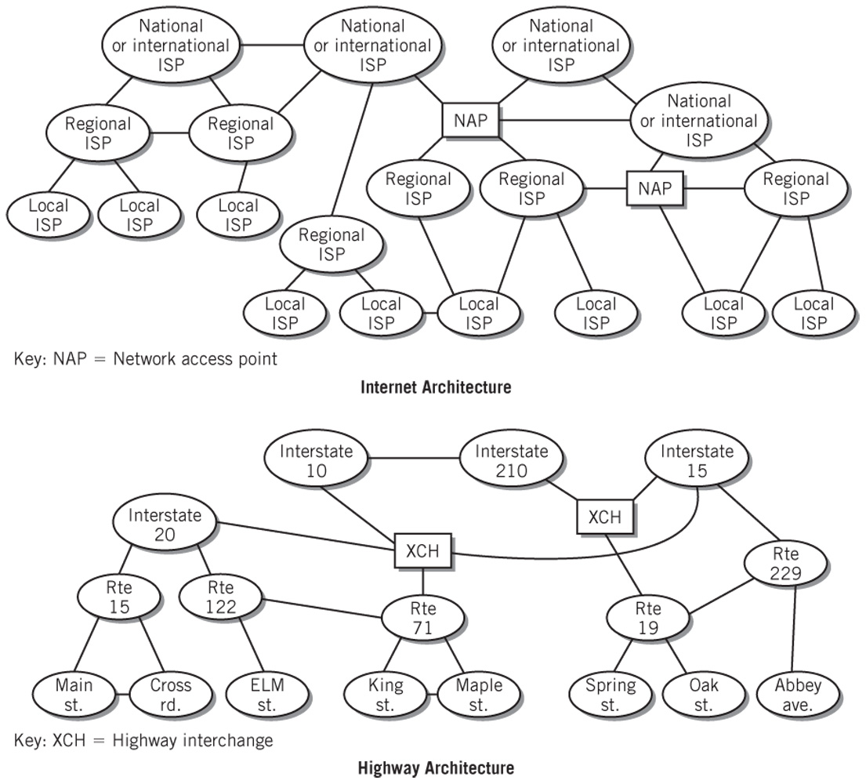
Comparison of Internet and Highway Architecture

Slide 66
Piconets
Also known as personal area networks (PAN)
Created for the personal use of an individual
Generally have ranges of 30 feet or less which is sufficient to permit an individual to interconnect personal computing devices
Connections between different cooperating users are possible but rare
Bluetooth is the primary medium for PANs
Example: interconnection between a cell phone, hands-free speaker and car radio

Slide 67
Standards Organizations
ISO (International Standards Organization)
> 17,000 standards including the OSI Reference model
IEEE (Institute for Electrical and Electronics Engineers
Ethernet standards – Ethernet (802.3), Wi-Fi (802.11), Bluetooth (802.15) and WiMax (802.16)
IETF (Internet Engineering Task Force)
Internet standards based on RFCs (request for comments)
ICANN
Internet Corporation for Assigned Names and Numbers
IP address allocation, domain name registration, protocol parameter assignment
Management of domain name and root server systems
IANA (Internet Assigned Numbers Authority
Registers application layer port numbers and specific parameter values used in Internet protocol headers

Slide 68
Copyright 2010 John Wiley & Sons
All rights reserved. Reproduction or translation of this work beyond that permitted in section 117 of the 1976 United States Copyright Act without express permission of the copyright owner is unlawful. Request for further information should be addressed to the Permissions Department, John Wiley & Sons, Inc. The purchaser may make back-up copies for his/her own use only and not for distribution or resale. The Publisher assumes no responsibility for errors, omissions, or damages caused by the use of these programs or from the use of the information contained herein.”

